Slide 1
Test Case Credit Approval
Andreas Yoga Parama

Slide 2
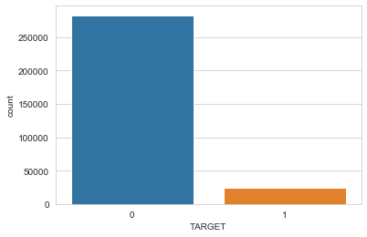
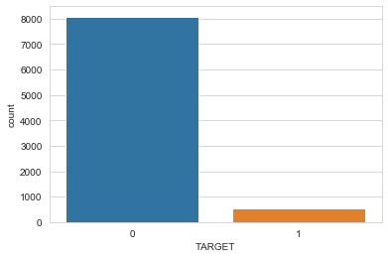
Data Cleaning
I do data imputation on the data with null value. It is the far more rational choice because I want to retain as many features as I can as because there are too many null values in the feature.
Filling null values with other values can create data bias as it is are not representative.
Mostly the null values are in the housing specification and amount of credit request. I suppose that those data are important as input to the model.
Imputed data count are 8.602, or 2.8% of total train data. Is the data still representative ? I think so. Because it is retain nearly the same distribution of two target classes.
In the original train data classes proportion is 92/8 and in the imputed data is 94/6.
Original data
Imputed data

Slide 3
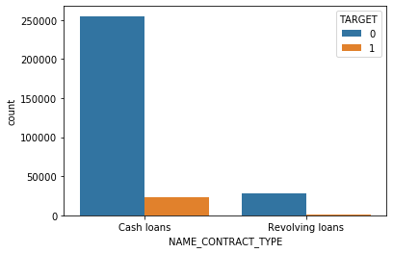
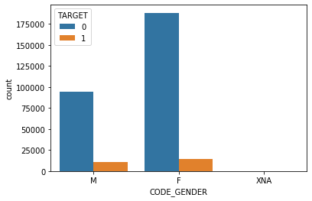
Exploratory Data Analysis
0 means that the customer had other cases
1 means that the customer have difficulties in paying the loans that can be caused to unapproved loans.
Most of the loans type are cash loans it also represent that most of the unapproved loans are in cash loans (23.221 cases) than in revolving loans (1.604 cases).
Our customer base in this data is mostly female that make about 65.83% of total customer. They also make up higher unapproved loans cases than male customer (14.170 by 10.655 cases).
Male customer are more tends to have unapproved loans request than female, it can be seems at the proportion. Male customers probability to had unapproved loans is (11.29%) than female customers (7.52%)

Slide 4
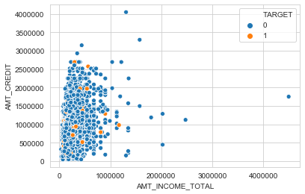
Exploratory Data Analysis
In this scatterplot I found no pattern that shows correlation between Income and amount credit to the target outcome.
The un-approved loans (1) are scattered and not gathered in one particular area. Most of the data value are below 1.000.000 and there is some extreme value that can be considered outlier.

Slide 5
Feature Engineering & Model Selection
I used all the features included and using pd.get_dummies to encode categorical feature
I use XGBClassifier on this model because it can handle missing data regardless I impute the data to get faster computing, and also XGB had better performance than other model regarding the computing speed and metric score.
XGBClassifier are based on Tree learning model, that can handle over categorical and numeric features and also not sensitive to central distribution, or can be said that immune to outlier.
To deal with imbalanced data I used Random OVersampler to adjust the minority class distribution so the model can predict better. Random Oversampling involves supplementing the training data with multiple copies of some of the minority classes. In this case is to eversample the 1 class (have trouble with payment).

Slide 6
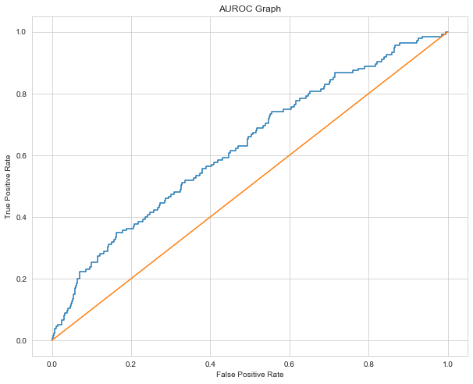
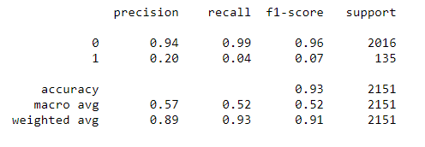
AUC ROC Score
AUC Score obtained for this model is 0.6271788653733098
Using cross_val_score model evaluation the mean of of AUC Score is 0.63961
with n_splits = 10 and n_repeats = 2
Why the model is not performing well enough ?
My assumption is because the imbalanced data and because
the positive class (1) is minority so the model are not getting
enough input for training the model. It is shown in the classification
report that the positive class prediction is very bad, or many of the
supposed positive class are predicted negative.

Slide 7
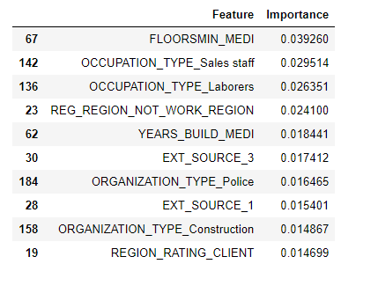
Feature Importances
Shows the most affecting feature to the model decision.
However, Feature importances are not in causal relation, i.e the lower a customer income cause the un-approval of the loans request.

Slide 8
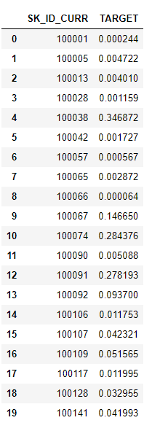
Test Data Prediction
Sample of predicted test data.

